Slide 1
3
APPLICATIONS OF
DIFFERENTIATION

Slide 2
3.3
Derivatives and the Shapes of Graphs

Slide 3
APPLICATIONS OF DIFFERENTIATION
Many applications of calculus depend on our ability to deduce facts about a function f from information concerning its derivatives.

Slide 4
DERIVATIVES AND GRAPH SHAPE
As f ’(x) represents the slope of the curve y = f(x) at the point (x, f(x)), it tells us the direction in which the curve proceeds at each point.
Thus, it is reasonable to expect that information about f’(x) will provide us with information about f(x).

Slide 5
What Does f ′ Say About f ?

Slide 6
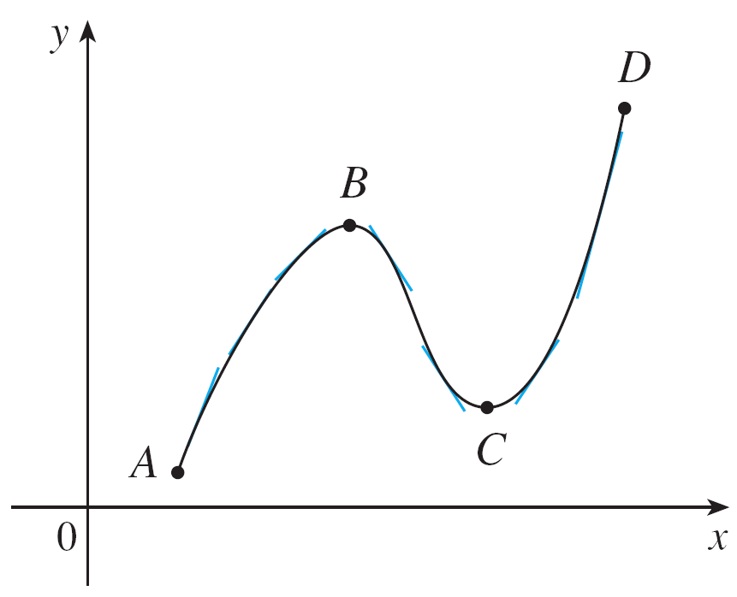
What Does f ′ Say About f ?
To see how the derivative of f can tell us where a function is increasing or decreasing, look at Figure 1.
Figure 1

Slide 7
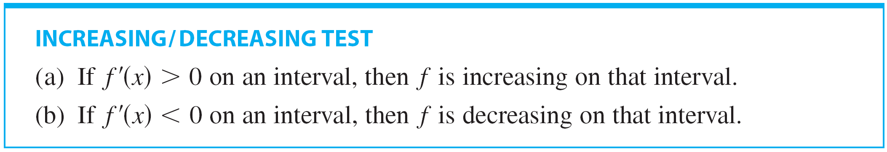
What Does f ′ Say About f ?
Between A and B and between C and D, the tangent lines have positive slopes and so f ′(x) > 0. Between B and C, the tangent lines have negative slopes and so f ′(x) < 0.
Thus it appears that f increases when f ′(x) is positive and decreases when f ′(x) is negative.

Slide 8
I/D TEST PROOF (a)
Let x₁ and x₂ be any two numbers in the interval with x₁ < x₂.
According to the definition of an increasing function, we have to show that f(x₁) < f(x₂).
Since we are given that f ’(x) > 0, we know that f is differentiable on [x₁, x₂].
So, by the Mean Value Theorem, there is a number c between x₁ and x₂ such that: f(x₂) – f(x₁) = f ’(c)(x₂ – x₁)

Slide 9
I/D PROOF (a)
Now, f ’(c) > 0 by assumption and x₂ – x₁ > 0 because x₁ < x₂ .
Thus, the right side of Equation 1 is positive.
So, f(x₂) – f(x₁) > 0 or f(x₁) < f(x₂)
This shows that f is increasing.
Part (b) is proved similarly.

Slide 10
Example 1
Find where the function is increasing and where it is decreasing.

Slide 11
Example 1 – Solution
SOLUTION:
To use the I/D Test we have to know where f ′(x) > 0 and where f ′(x) < 0.
This depends on the signs of the three factors of f ′(x), namely, 12x, x – 2, and x + 1.

Slide 12
Example 1 – Solution
cont’d
We divide the real line into intervals whose endpoints are the critical numbers –1, 0, and 2 and arrange our work in a chart.
A plus sign indicates that the given expression is positive, and a minus sign indicates that it is negative.

Slide 13
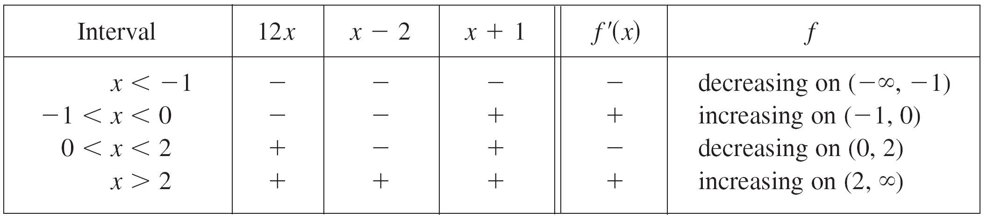
Example 1 – Solution
cont’d
The last column of the chart gives the conclusion based on the I/D Test. For instance, f ′(x) < 0 for 0 < x < 2, so f is decreasing on (0, 2). (It would also be true to say that f is decreasing on the closed interval [0, 2].)

Slide 14
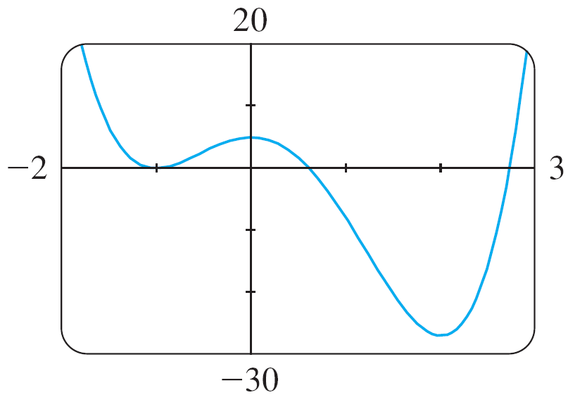
Example 1 – Solution
cont’d
The graph of f shown in Figure 2 confirms the information in the chart.
Figure 2

Slide 15
What Does f ′ Say About f ?
If f has a local maximum or minimum at c, then c must be a critical number of f (by Fermat’s Theorem), but not every critical number gives rise to a maximum or a minimum.
We therefore need a test that will tell us whether or not f has a local maximum or minimum at a critical number.
You can see from Figure 2 that f (0) = 5 is a local maximum value of f because f increases on (–1, 0) and decreases on (0, 2).
Figure 2

Slide 16
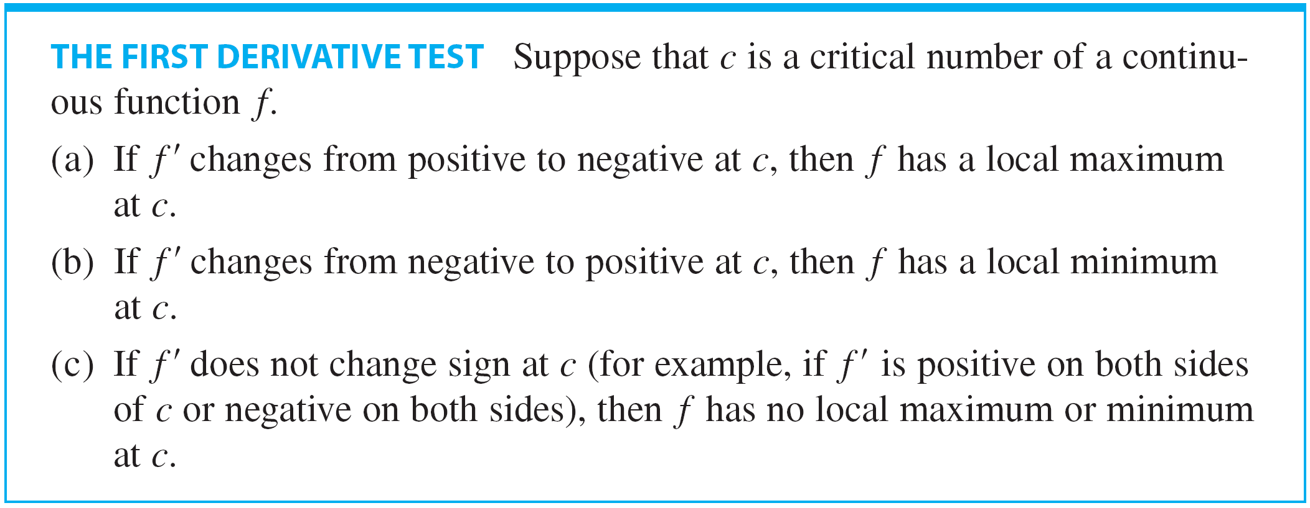
What Does f ′ Say About f ?
Or, in terms of derivatives, f ′(x) > 0 for –1 < x < 2 and f ′(x) < 0 for 0 < x < 2.
In other words, the sign of f ′(x) changes from positive to negative at 0. This observation is the basis of the following test.

Slide 17
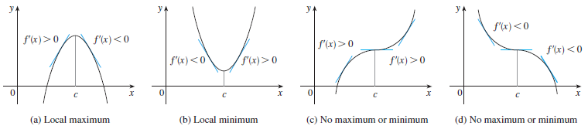
What Does f ′ Say About f ?
The First Derivative Test is a consequence of the I/D Test.
It is easy to remember the First Derivative Test by visualizing diagrams such as those in Figure 3.
Figure 3

Slide 18
THE FIRST DERIVATIVE TEST
The First Derivative Test is a consequence of the I/D Test.
For instance, in (a), since the sign of f’(x) changes from positive to negative at c, f is increasing to the left of c and decreasing to the right of c.
It follows that f has a local maximum at c.

Slide 19
Example 2
Find the local minimum and maximum values of the function f in Example 1.
SOLUTION:
From the chart in the solution to Example 1, we see that f’(x) changes from negative to positive at – 1.
So, f(– 1) = 0 is a local minimum value by the First Derivative Test.

Slide 20
Example 2 SOLUTION
Similarly, f ’ changes from negative to positive at 2.
So, f(2) = – 27 is also a local minimum value.
As previously noted, f(0) = 5 is a local maximum value because f’(x) changes from positive to negative at 0.

Slide 21
Example 3
Find the local maximum and minimum values of the function g(x) = x + 2 sin x 0 ≤ x ≤ 2π
SOLUTION
To find the critical numbers of g, we differentiate: g’(x) = 1 + 2 cos x
So, g’(x) = 0 when cos x = – ½.
The solutions of this equation are 2π/3 and 4π/3.

Slide 22
Example 3 SOLUTION
As g is differentiable everywhere, the only critical numbers are 2π/3 and 4π/3.
So, we analyze g in the following table.

Slide 23
Example 3 SOLUTION
As g’(x) changes from positive to negative at 2π/3, the First Derivative Test tells us that there is a local maximum at 2π/3.
The local maximum value is:

Slide 24
Example 3 SOLUTION
Likewise, g’(x) changes from negative to positive at 4π/3.
So, a local minimum value is:

Slide 25
Example 3 SOLUTION
The graph of g in Figure 4 supports our conclusion.

Slide 26
What Does f ′′ Say About f ?

Slide 27
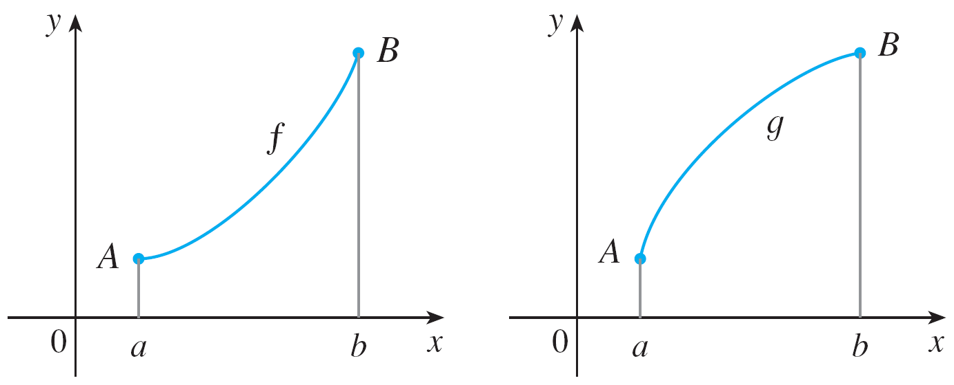
What Does f ′′ Say About f ?
Figure 5 shows the graphs of two increasing functions on (a, b).
Both graphs join point A to point B but they look different because they bend in different directions. How can we distinguish between these two types of behavior?
(a)
Figure 5
(b)

Slide 28
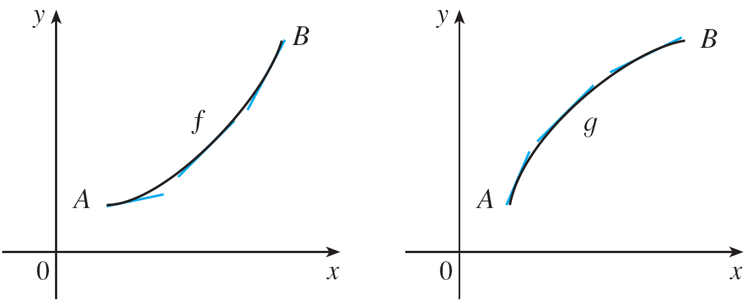
What Does f ′′ Say About f ?
In Figure 6 tangents to these curves have been drawn at several points.
In (a) the curve lies above the tangents and f is called concave upward on (a, b). In (b) the curve lies below the tangents and g is called concave downward on (a, b).
(a) Concave upward
(b) Concave downward
Figure 6

Slide 29
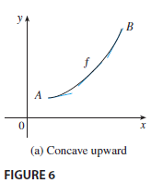
What Does f ′′ Say About f ?
Let’s see how the second derivative helps determine the intervals of concavity. Looking at Figure 6(a), you can see that, going from left to right, the slope of the tangent increases.
This means that the derivative f’ is an increasing function and therefore its derivative f ′′ is positive.

Slide 30
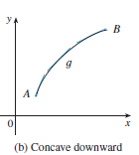
What Does f ′′ Say About f ?
Likewise, in Figure 6(b) the slope of the tangent decreases from left to right, so f’ decreases and therefore f ′′ is negative.
This reasoning can be reversed and suggests that the following theorem is true.

Slide 31
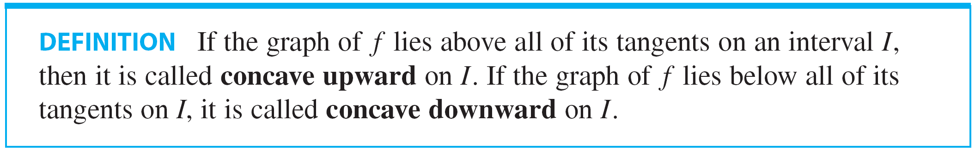
What Does f ′′ Say About f ?

Slide 32
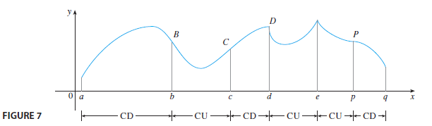

What Does f ′′ Say About f ?
Figure 7 shows the graph of a function that is concave upward (abbreviated CU) on the intervals (b,c) (d,e), and (e,p) and concave downward (CD) on the intervals (a,b), (c,d), and (p,q).

Slide 33

What Does f ′′ Say About f ?
In view of the Concavity Test, there is a point of inflection at any point where the second derivative changes sign.

Slide 34
Example 4
Sketch a possible graph of a function f that satisfies the following conditions:
f’(x) > 0 on (– ∞, 1), f’(x) < 0 on (1, ∞)
f”(x) > 0 on (– ∞, – 2) and (2, ∞), f’’(x) < 0 on (– 2, 2)

Slide 35
Example 4 SOLUTION
Condition (i) tells us
That f is increasing on (– ∞, 1) and decreasing on (1, ∞).
Condition (ii) says
That f is concave upward on (– ∞, – 2) and (2, ∞), and concave downward on (– 2, 2).
From condition (iii)
We know that the graph of has two horizontal asymptotes: y = – 2 and y = 0.

Slide 36
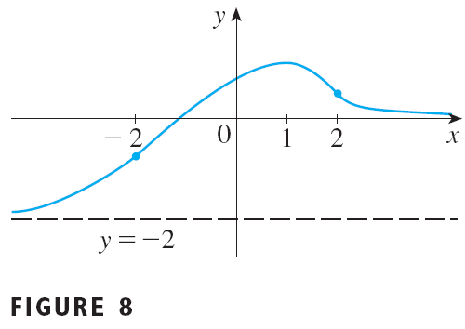
Example 4 SOLUTION
We first draw the horizontal asymptote as a dashed line (see Figure 8).

Slide 37
Example 4 SOLUTION
We then draw the graph of f approaching this asymptote at the far left, increasing to its maximum point at x = 1 and decreasing toward the x-axis at the far right.
We also make sure that the graph has inflection points when x = – 2 and 2.
Notice that we made the curve bend upward for x < – 2 and x > 2, and bend downward when x is between 2 and 2.

Slide 38

THE SECOND DERIVATIVE TEST
Another application of the second derivative is the following test for maximum and minimum values.
It is a consequence of the Concavity Test.

Slide 39
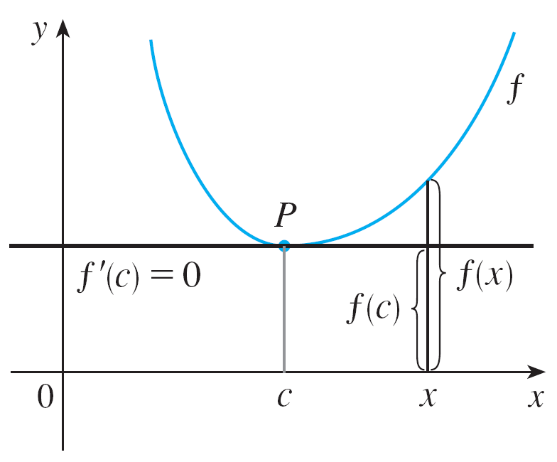
What Does f ′′ Say About f ?
For instance, part (a) is true because f ′′(x) > 0 near c and so f is concave upward near c.
This means that the graph of f lies above its horizontal tangent at c and so f has a local minimum at c. (See Figure 9.)
f ′′(c) > 0, f is concave upward
Figure 9

Slide 40

Example 5
Discuss the curve with respect to concavity, points of inflection, and local maxima and minima. Use this information to sketch the curve.

Slide 41

Example 5- Solution
SOLUTION:
If , then

Slide 42




Example 5 – Solution
cont’d
To find the critical numbers we set f ′(x) = 0 and obtain x = 0 and x = 3.
To use the Second Derivative Test we evaluate f ′′ at these critical numbers:
Since and , is a local minimum.
Since the Second Derivative Test gives no information about the critical number 0.

Slide 43
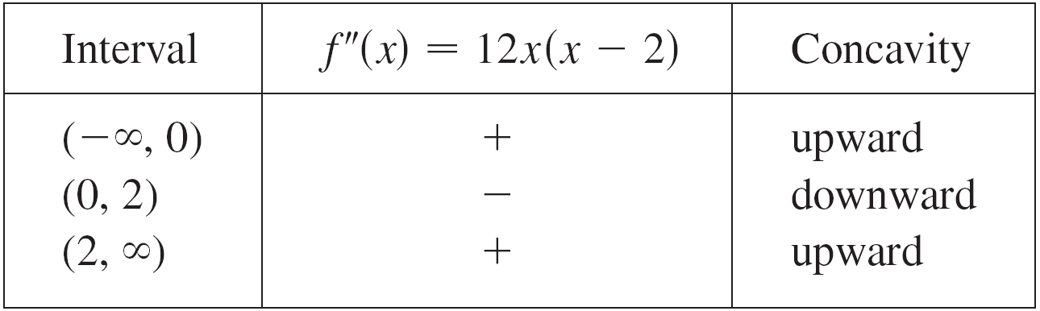
Example 5 – Solution
cont’d
But since f ′(x) < 0 for x < 0 and also for 0 < x < 3, the First Derivative Test tells us that f does not have a local maximum or minimum at 0. [In fact, the expression for f ′(x) shows that f decreases to the left of 3 and increases to the right of 3.
Since f ′′(x) = 0 when x = 0 or 2, we divide the real line into intervals with these numbers as endpoints and complete the following chart.

Slide 44
Example 5 – Solution
cont’d
The point (0,0) is an inflection point since the curve changes from concave upward to concave downward there.
Also (2, –16) is an inflection point since the curve changes from concave downward to concave upward there.

Slide 45
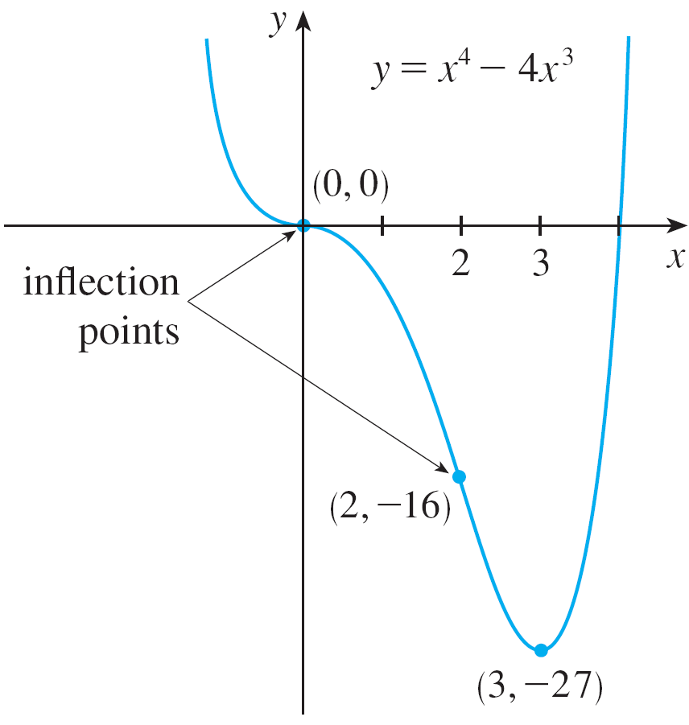
Example 5 – Solution
cont’d
Using the local minimum, the intervals of concavity, and the inflection points, we sketch the curve in Figure 10.
Figure 10

Slide 46
NOTE
The Second Derivative Test is inconclusive when f’’(c) = 0.
In other words, at such a point, there might be a maximum, a minimum, or neither (as in example 5).
The test also fails when f’’(c) does not exist.
In such cases, the First Derivative Test must be used.
In fact, even when both tests apply, the First Derivative Test is often the easier one to use.

Slide 47
Example 6
Sketch the graph of the function f(x) = x^{2/3}(6 – x)^{1/3}
SOLUTION
You can use the differentiation rules to check that the first two derivatives are:
As f ’(x) = 0 when x = 4 and f ’(x) does not exist when x = 0 or x = 6, the critical numbers are 0, 4, and 6.

Slide 48
Example 6 SOLUTION
To find the local extreme values, we use the First Derivative Test.
As f ’ changes from negative to positive at 0, f(0) = 0 is a local minimum.
Since f’ changes from positive to negative at 4, f(4) = 2^{5/3} is a local maximum.
The sign of f’ does not change at 6, so there is no minimum or maximum there.

Slide 49
Example 6 SOLUTION
The Second Derivative Test could be used at 4, but not at 0 or 6—since f ’’ does not exist at either of these numbers.
Looking at the expression for f ’’(x) and noting that x^{4/3} ≥ 0 for all x, we have:
f ’’(x) < 0 for x < 0 and for 0 < x < 6
f ’’(x) > 0 for x > 6

Slide 50
Example 6 SOLUTION
So, f is concave downward on (– ∞, 0) and (0, 6) and concave upward on (6, ∞), and the only inflection point is (6, 0).
Note that the curve has vertical tangents at (0, 0) and (6, 0) because |f ’(x)| → ∞ as x → 0 and as x → 6.

